Slide 1
Android Study Jams
Presenter Guide

Slide 2
What’s the purpose of this deck?
To explain the presenter and facilitator role
To explain how to create attendee slides
INTRO

Slide 3
Encourage, guide,
and learn with your attendees
YOUR ROLE

Slide 4
Encourage your attendees
Acknowledge their progress and hard work
Send meeting reminder to participants through email and social media
Motivate them throughout the program
YOUR ROLE

Slide 5
Guide your attendees
Complete the coursework before leading the session. Take notes throughout the course and turn that into your slide deck. Pass the quiz for each pathway (unlimited retries).
Find out where people get stuck & help them get unstuck
Be available for questions and find teaching assistants to help too
YOUR ROLE

Slide 6
Learn with your attendees
You don’t need to know everything—work through problems with them so they can learn how to debug too!
Entice them with a reason to come back for the next session (screenshot upcoming apps and show preview of what they’ll learn next)
YOUR ROLE

Slide 7
Creating your own slides for Android Study Jams session
SLIDES DESIGN

Slide 8
Slide decks should be ~15 mins
and cover main concepts at the
beginning of each study jam session
SLIDES DESIGN

Slide 9
1
2
3
Introduction
Concepts
Logistics
Start with an open question or video to generate discussion and engage everyone. Afterwards, show the schedule to get everyone aligned on the goals of the session.
Explain the overarching concepts and theory to save people time while they’re working.
Introduce the platforms that people will be using, so they’re more comfortable during the session (here’s where you can do a demo)
SLIDES DESIGN

Slide 10
Concept Slides
SLIDES DESIGN
You can extract high-level learning objectives before the session
Pull from the “What You’ll Learn” section at the beginning of each codelab (example)
You can look up topics on developer.android.com and see if there’s a guide on it. Then extract main points from that for the slides (such as this guide on Navigation Component).

Slide 11
Concept Slides
SLIDES DESIGN
Explain general concepts to save time
Add a slide if:
It will take 10 minutes for someone to understand a concept. Save activity time by explaining it beforehand.
You think more than 20% of the attendees will ask you about it
It’s a new or nuanced concept that isn’t covered in the labs
When in doubt, don’t add a slide! Be conservative with the slides you add so you can dive into the activity as soon as possible.

Slide 12
Design Tips for Slides
SLIDES DESIGN
How to make your presentation more engaging
Think about your slides last. Define your main message and structure its supporting points—and then think about your slides. It’s more effective when slides are visuals that add to your words.
Use a consistent look and feel. Utilize type, colors, and graphics that are consistent. We've provided a template you can use for your presentations.
Design for topic transitions. Make sure your topic transitions are visually distinct.

Slide 13
Design Tips for Slides
SLIDES DESIGN
With text, less is almost always more. If you can’t avoid adding a lot of text, progressively reveal text with transitions as you need it.
Use images that enhance meaning. Look for images that speak strongly to the concept you’re talking about.
With code, progressively reveal when relevant. Style code to look like that within a code editor to distinguish from supplementary text. You can use this tool.
Use indications (arrows, shapes) to direct attention in images.

Slide 14
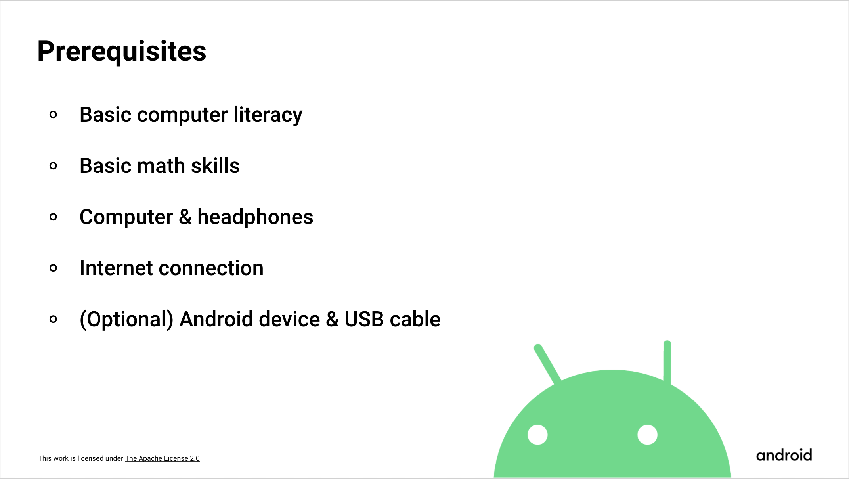
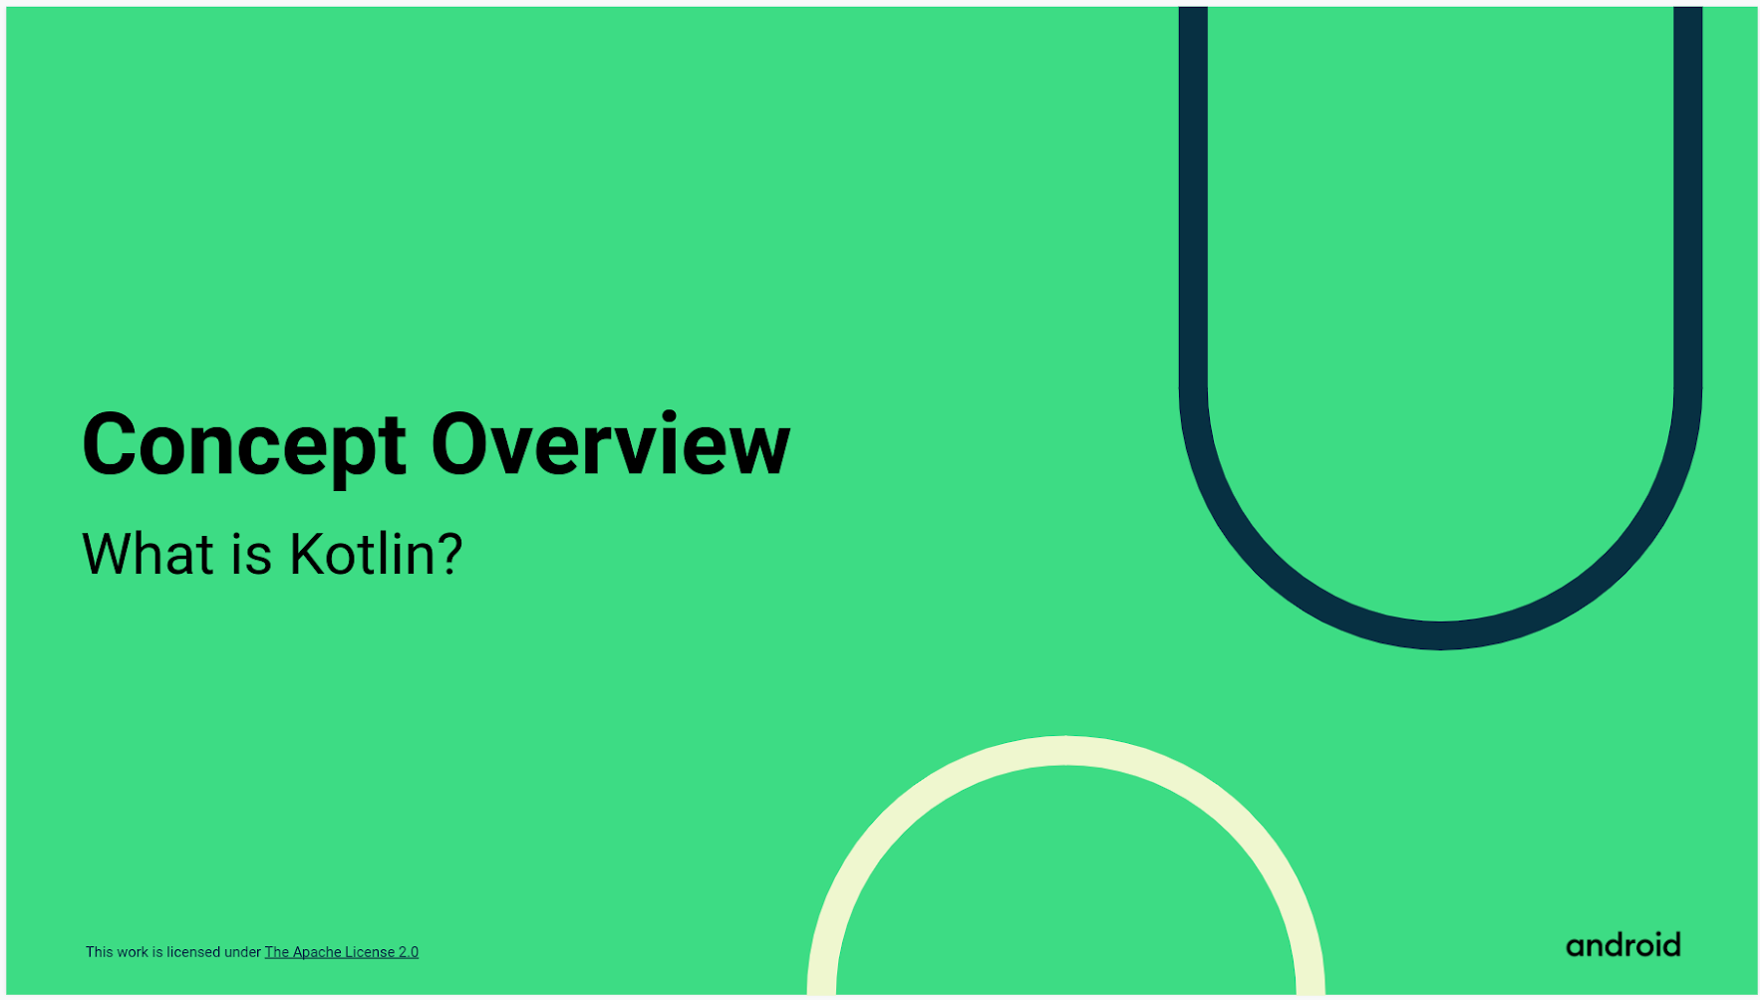
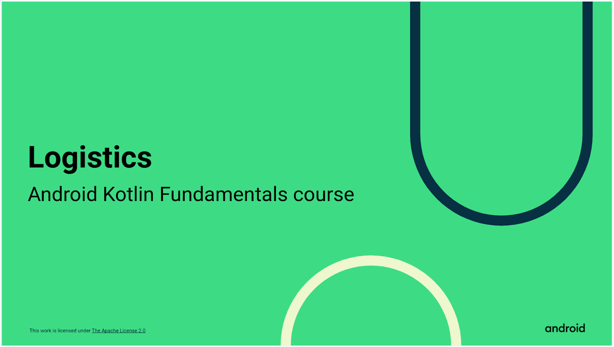
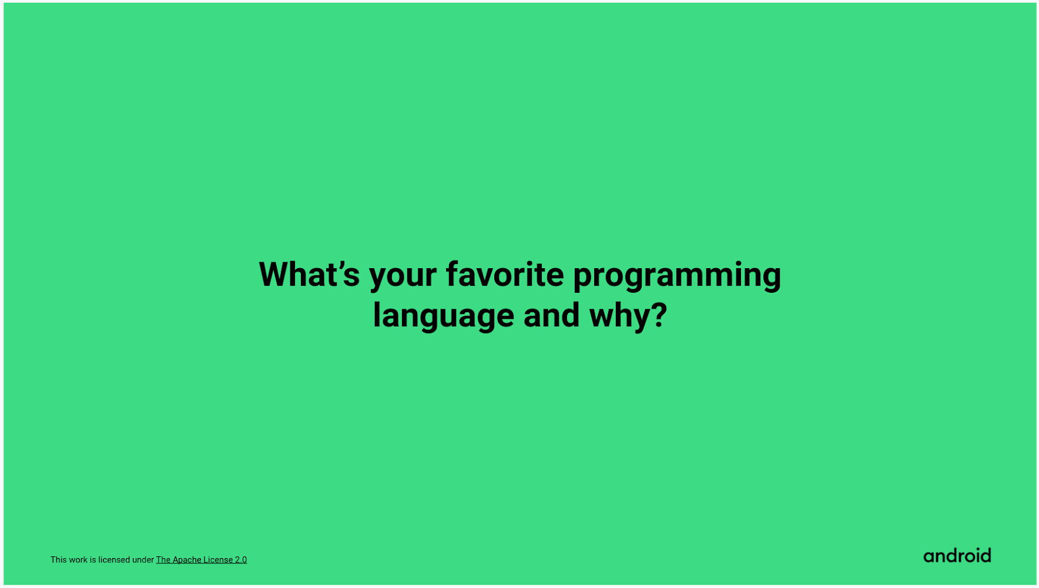
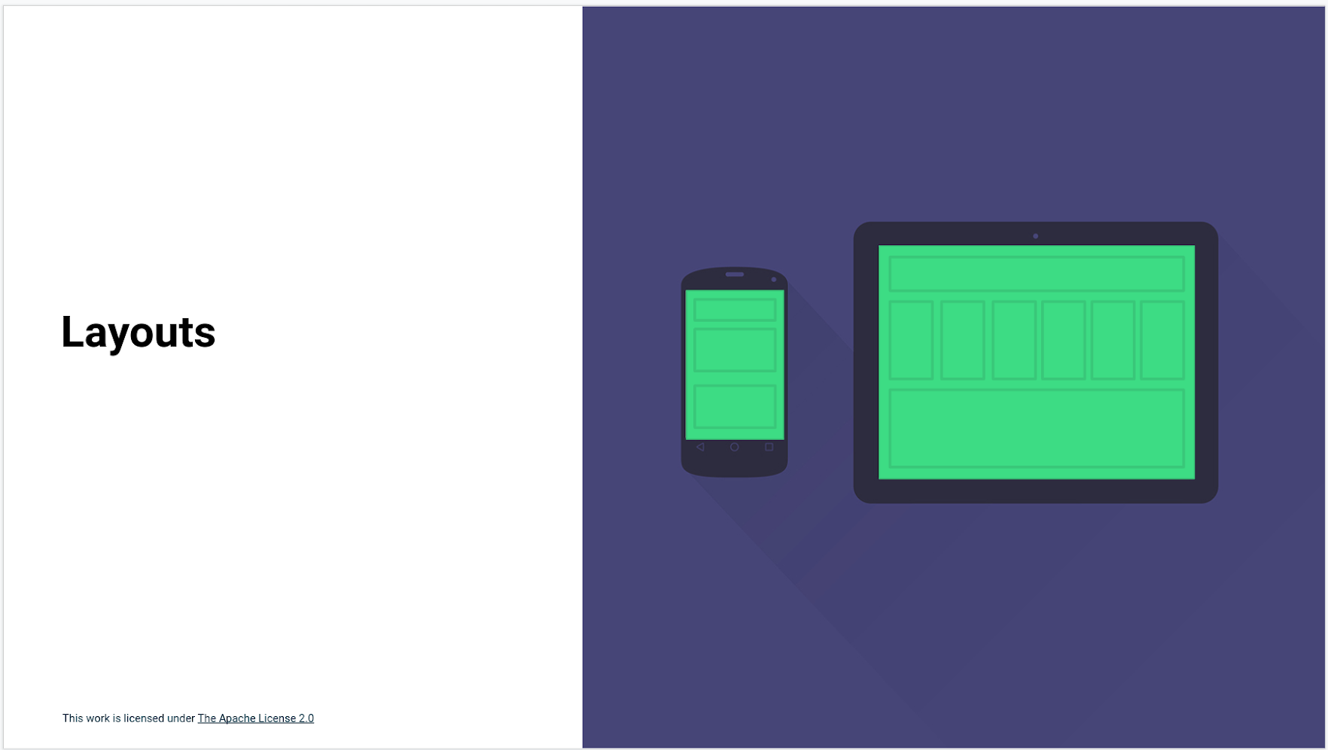
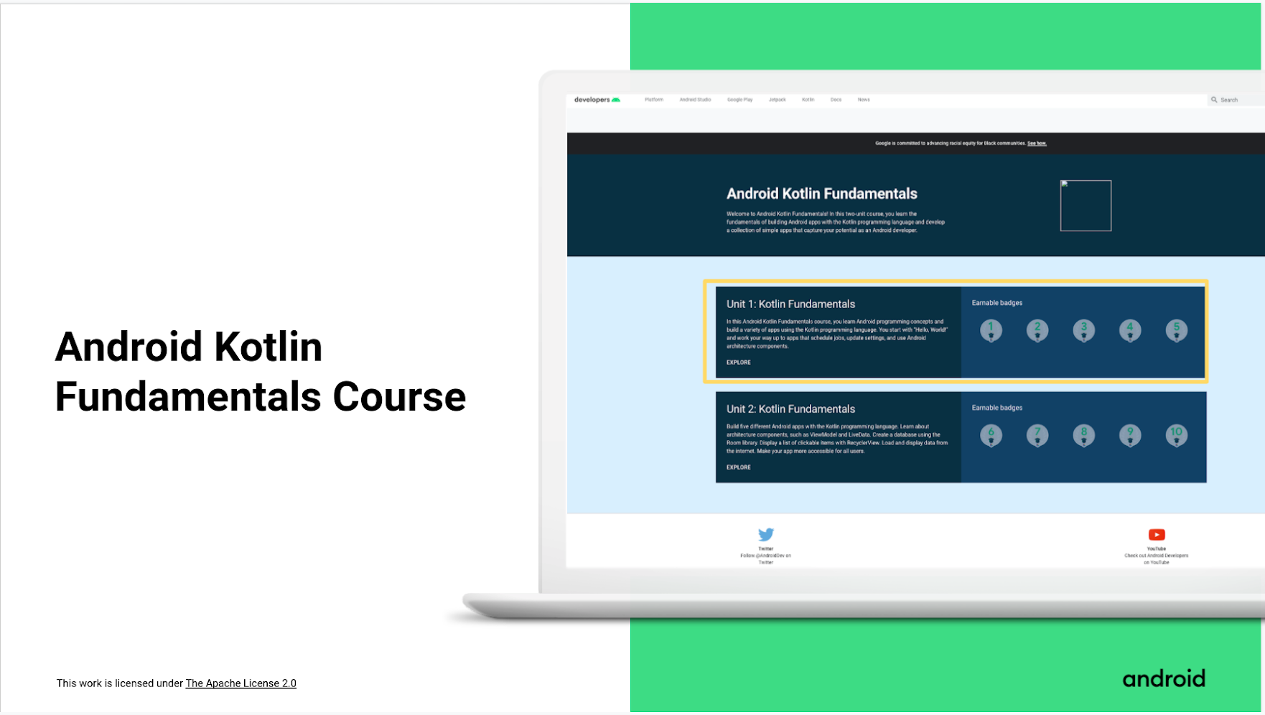
Examples
Look at other presentations with similar formats
1. Introduction
2. Concepts
3. Logistics
SLIDES DESIGN
Attendee Slides for Prior Programming Experience Track Sessions 1 & 2

Slide 15
Additional Resources
Online curriculum
Android Basics in Kotlin Course
Android Kotlin Fundamentals Course
Udacity Developing Android Apps with Kotlin Course
Udacity Advanced Android with Kotlin
Android Resources
Official Android Developers website
Android Developers YouTube channel
Android Developers Twitter
Android Developers Medium blog
Android Developers Official blog
Android Developers Newsletter
Android Codelabs
Android GitHub page
Kotlin Language Resources
Official Kotlin Language website
Kotlin Learn by Example
Kotlin Vocabulary series
Version 1.0

